Slide 1
Global Ads Performance
Statistics & Machine Learning
Namrata Bhoyar | Nihal Pujari | Anuj Kamble |
Gourav Somanna | Pramodkumar Shivanna

Slide 2
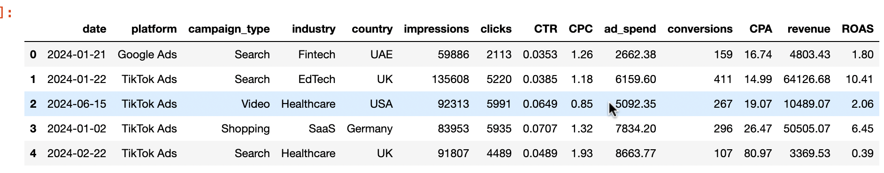
Dataset
Source: Kaggle (Global Ads Performance Dataset ).
Shape: 1800 Observations across 14 Features.
Key Features: Platform, Industry, Country, Impressions, Clicks, Ad Spend, Revenue, ROAS.

Slide 3
Problem Statement
Platform ROI Comparison: Test if ROAS differs significantly across TikTok, Meta, and Google platforms using statistical hypothesis testing.
Conversion Forecasting: Use Supervised Learning to predict campaign conversions based on engagement metrics.
Profitability Classification: Classify campaigns as "Winners" (ROAS > 1) using pre-revenue indicators.
Market Segment Discovery: Identify hidden campaign archetypes using Unsupervised Clustering.

Slide 4
Preprocessing & Feature Engineering
Data Cleaning.
Feature Engineering:
  Extracted Time features (Month, Week, Day of Week).
  Recalculated Columns for data integrity.

Slide 5
Noise Injection & Cleaning
The Experiment: Injected 3% Multiplicative Gaussian Noise into financial columns (ad_spend, clicks) to simulate real-world data logging errors.
Cleaning Method: Applied Quantile Smoothing to mitigate noise impact.
Results:
  Comparison of Original vs. Noisy vs. Cleaned distributions.
  Finding: Robust cleaning preserved the mean while reducing the variance introduced by the noise.

Slide 6
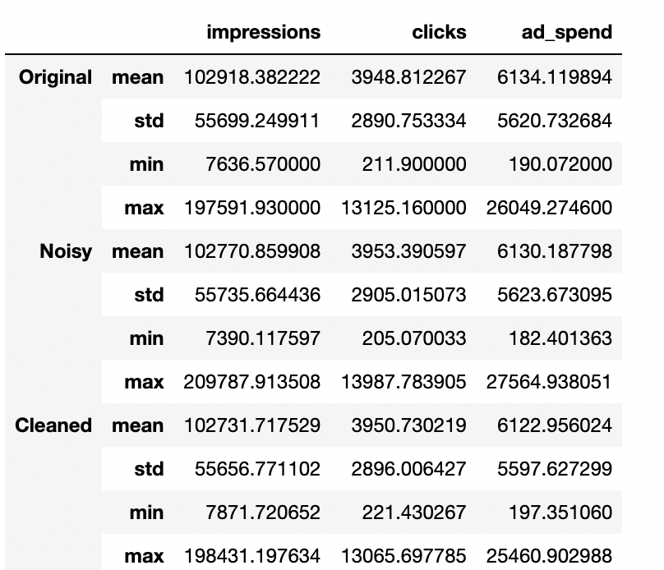
Noise Injection & Cleaning

Slide 7
Statistical Analysis
Descriptive Metrics: Calculated Mean, Variance, and Skewness for all KPIs.
Hypothesis Testing: Conducted a Kruskal-Wallis H-test.
  Result: Found statistically significant differences in ROAS between platforms (p < 0.05).
Visuals:
  Correlation Heatmap (Identifying drivers of Revenue).
  Boxplots (Visualising platform variance).
  Histograms (ROAS distribution skewness).

Slide 8
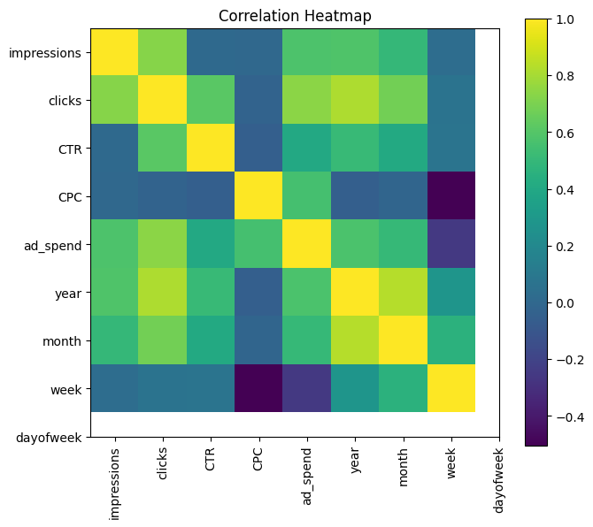
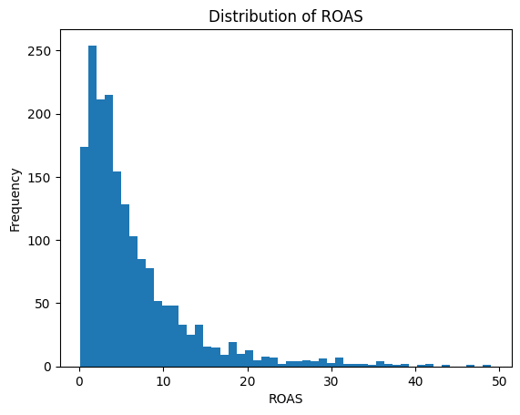
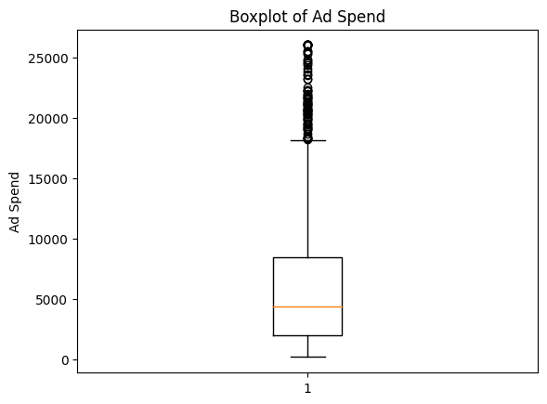
Statistical Analysis

Slide 9
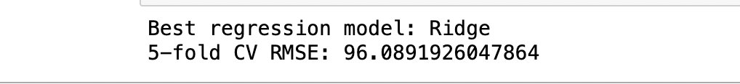
Supervised Learning - Regression
Goal: Forecast Conversion Counts.
Models Compared: Ridge Regression vs. Random Forest Regressor.
Evaluation Metrics: MAE, RMSE, and R².
Performance:
  Random Forest .

Slide 10
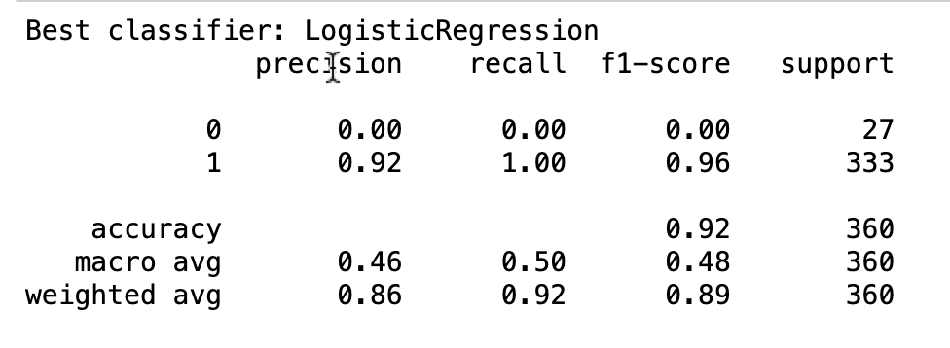
Supervised Learning - Classification
Goal: Predict Profitability (ROAS > 1).
Model: Random Forest Classifier.
Evaluation: F1-Score and ROC-AUC.
Robustness Check:
  Tested the model on Noisy Data.
  Finding: The model maintained a high AUC even with 3% noise, proving high generalised reliability.

Slide 11
Unsupervised Learning
Method: Dimensionality Reduction (PCA) followed by K-Means Clustering.
Optimisation: Used Silhouette Scores to find the optimal number of clusters (k).
Cluster Interpretation:
  Cluster 0: High-efficiency, low-spend (The "Viral" campaigns).
  Cluster 1: High-spend, established scale.
  Cluster 2: Underperforming segments needing optimisation.

Slide 12
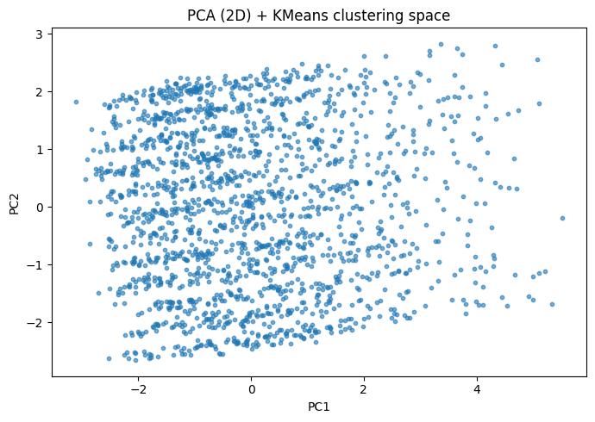
Unsupervised Learning

Slide 13
Justification & Creativity
Why Random Forest? Handles non-linear advertising data and complex platform interactions better than linear models.
Why PCA? Reduced 14+ dimensions into 2 components for clearer visual segmentation.
Creativity Highlights:
  Used Scikit-Learn Pipelines to prevent Data Leakage.
  Integrated Statistical Hypothesis Testing with Machine Learning.
  Performed Robustness Testing against artificial noise.

Slide 14
Conclusion
Winner: TikTok Ads showed higher agility in specific niches (EdTech/Fintech).
Summary: Our model can predict campaign success with >90% accuracy.
Future Work: Integrate real-time API data for live forecasting.

Slide 15
References
https://www.kaggle.com/datasets/nudratabbas/global-ads-performance-google-meta-tiktok/data
https://scikit-learn.org/

Slide 16
Thank You

